Slide 1
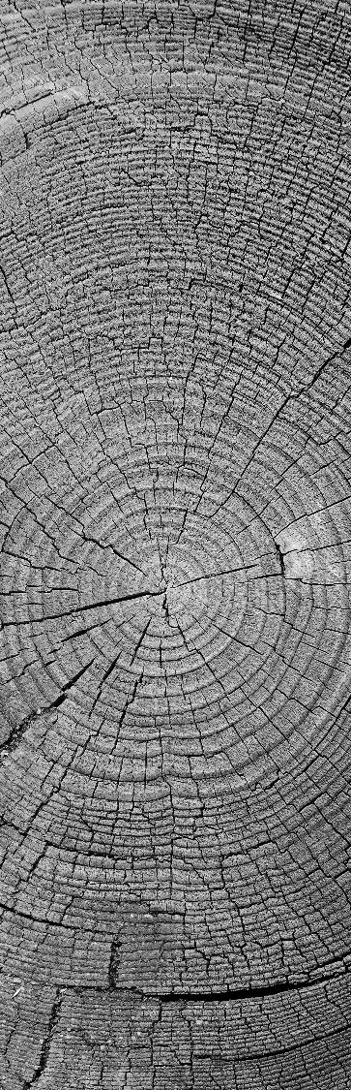
Pay Gap representation
Social statistics away-day May 2024
By Wendy Olsen with thanks to Myong Sook Kim

Slide 2
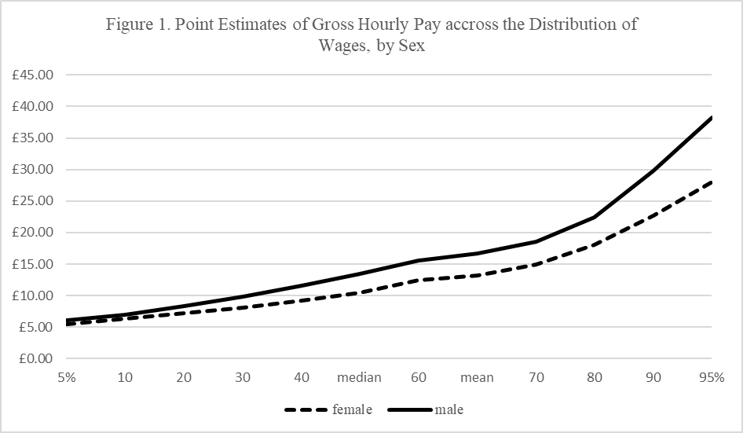
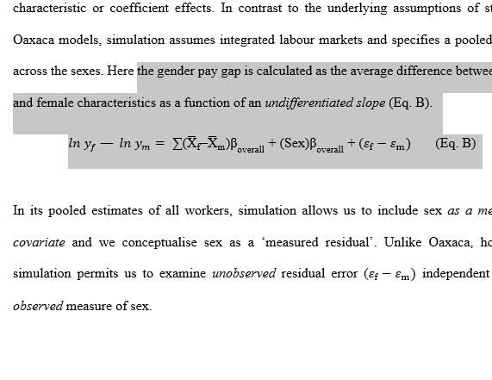
A Pay gap could be at the mean or the median.
It is inherently an aggregate statistic.
Example: male mean vs female mean, omitting the 0’s (non-earners). The distribution of earnings that we use is often “usual” earnings per hour, in the main job.
This saves confusion and invalid comparisons
We use the logarithm of pay if everyone has a job
“Actual earnings” is considered more accurate.

Slide 3
Ll is lower limit of the 95% Wald confidence interval
Ul is the upper limit of the 95% Wald confidence interval
The pay is per person per month
0, Uganda Wave 1
0, Uganda Wave 2
0, Peru
300
200
100
0
(mean) EARN_LSTMNTH_TOT_D_INCFW_USD
1, Uganda Wave 1
1, Uganda Wave 2
1, Peru
ul/ll
300
collapse (mean) meanearnmjincusd = EARN_LSTMNTH_TOT_D_INCFW_USD (median) medianearnmjincusd = EARN_LSTMNTH_TOT_D_INCFW_USD (semean) semeanearnmjincusd = EARN_LSTMNTH_TOT_D_INCFW_USD [aweight = WEIGHT_FINAL], by(female wave)
lab var female "Gender of Respondent"
lab def female 0 "Male" 1 "Female", modify
lab var female female
list
gen ll=meanearnmjincusd-1.96*semeanearnmjincusd
gen ul=meanearnmjincusd+1.96*semeanearnmjincusd
gen llmed=medianearnmjincusd-1.96*semeanearnmjincusd
gen ulmed=medianearnmjincusd+1.96*semeanearnmjincusd
graph bar meanearnmjincusd female, by(wave female)
graph twoway (bar meanearnmjincusd female , by(female wave )) (rcap ul ll female, by(female wave ))
*Here we can also use the pay median*
graph export "results\comparemeanearnsBysexInwave.wmf", replace
200
100
0
-.5
0
.5
1
1.5
-.5
0
.5
1
1.5
-.5
0
.5
1
1.5
female
The first panel is the Males
The second panel is the Females
We have waves 1 and 2 in Uganda
At right, Peru has just one wave.
Graphs by female and Which Part of the Survey

Slide 4
How to adjust color and labels on bars
graph bar EARN_LSTMNTH_TOT_D_INCFW_USD [pweight=WEIGHT_FINAL] if inlist(ICSE18_MJJ,3,4,5) , over(sex) over(agegroup3) over(wave) bar(1, color(sand)) bar(2,color(gold)) legend(size(vsmall)) blabel(bar, format(%9.1f) size(2)) ytitle("USD/Month, Females Yellow, Males Darker")
So after you collapse, you will need to adjust the twoway graph to use a categorical variable, so that over can refer to Bar 1, Bar 2, etc. This is awkward in twoway grapsh but it can be manipulated.

Slide 6
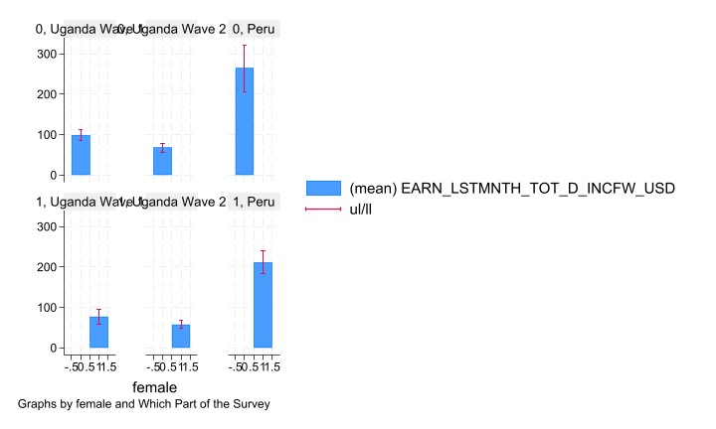
Source: International Labour Organisation
Primary survey data, experimental research on questionnaire design, 2022.
TRICKSY NOT AN ADEQUATE PAYGAP TILL PER-HOUR
Here, pay is per month, estimated from the last paypacket, among only those who had pay. It refers only to adults in the main job.
Furthermore it includes the in-kind pay, converted by respondent to local currency.
The currency is US $ per person per month.

Slide 7
The pay is per month, estimated from the last paypacket, among only those who had pay. It refers only to adults in the main job.
Furthermore in includes the in-kind pay, converted by respondent to local currency.
TRICK: If the pay is per month, estimated from the last paypacket, something has been left out of the analysis.
You do not see significant gender difference (red marks the 95% Wald confidence interval) – WHY NOT!!?? There IS a large and significant pay gap in Uganda and Peru - - why not shown?

Slide 8
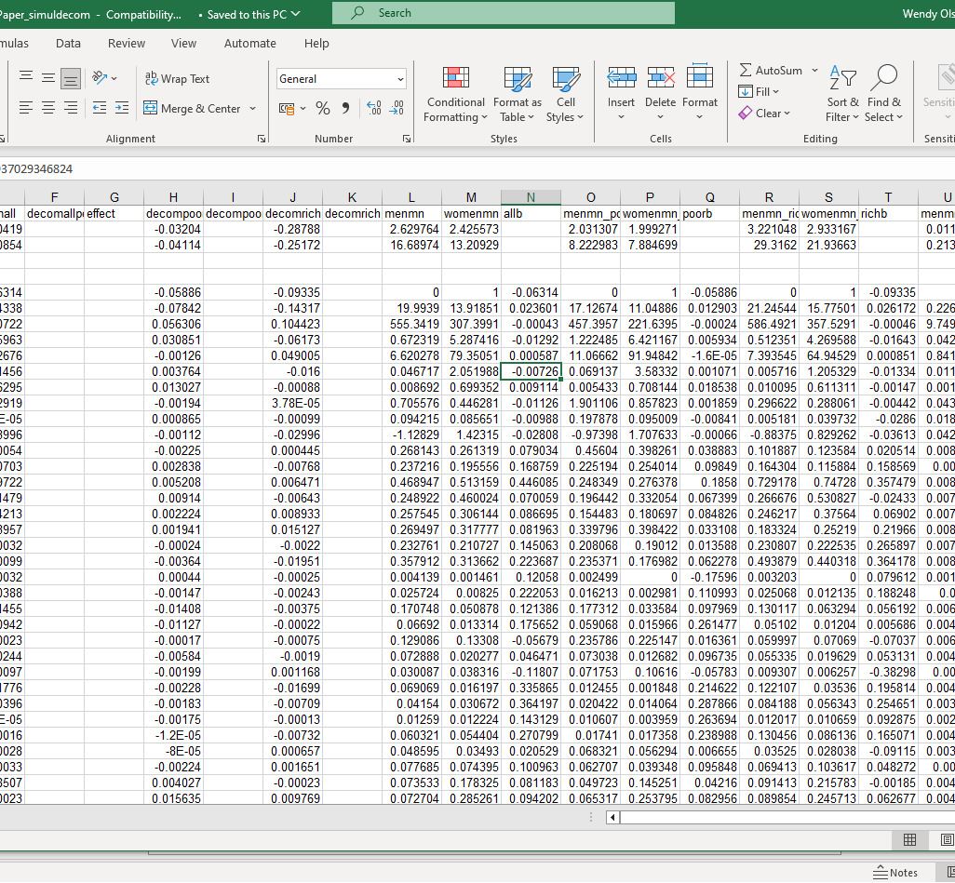
+ also, need to Deal with missing data
What about the inactive people with no job, and the unemployed?
You can possibly impute to them a £1 or $1 payment (per hour).
This safely places them at the far left of the distribution.
Regression calculations are sometimes done this way.
A hurdle regression has two steps. First, what predicts them being in the zero group, and second, what predicts the value of the Y variable for non-zero cases.

Slide 9
Comparison using rcap in stata
A simple comparison of the mean wage-rate by sex gives the ‘gender pay gap’
The pay gap at the mean
Variant Pay-Gaps
In Stata, you will:
Preserve
Collapse
Twoway graph …( Hbar ) ..(rcap…)
The same categorical variable but different continuous variables. I use llmen and ulmen, and llwomen and ulwomen as variable names in the collapse command
You need to use your Pweights or Aweights in the collapse command
Then graph … (rcap ulmen llmen) and so on.
Most obviously, you can do the pay gap at the median wage-rate.
Monthly earnings is not a good idea because it ignores the part-time working hours. Therefore, it will exaggerate the gender pay gap.
You also want to create a sexual-orientation pay gap? Make sure you give the confidence interval for the smaller group, especially if N<30 for the calculation of one of the means.
Ethnicity Pay Gaps
Disability Pay Gaps … etc.
All part of inequalities research.

Slide 10
Figure 1 Log pay gap regression & Decomposition
CJE article – version before the revisions – The Poor group is lowest 12%.
The working poor are defined as workers living in households with equivalised income <60% of median earned income (£1,335 or less). Here, it is the bottom 12% of households. We apply a similar cut-off on the right-hand side, >160% of median, N=10,275

Slide 11
SOOK kim MADE GREAT CONTRIBUTIONs
Work histories measured as one-month units on annual recall, overlapping, corrected.
All code reproducible and open-access.
Table 1. Key Descriptive Statistics, weighted by cross-sectional weights
 | All Households |  | Poor Households |  | Wealthy Households
 | Men | Women | Men | Women | Men | Women
Gross Hourly Pay | £16.67 | £13.21 | £8.22 | £7.90 | £29.20 | £21.95
Gender Pay Gap | 20% |  | 4% |  | 28%
Cumulative Work History, in years and proportion of time in each status:
Full-time work | 19.98 (0.93) | 13.93 (0.62) | 17.13 (0.83) | 11.06 (0.49) | 21.17 (0.96) | 15.84 (0.71)
Part-time work | 0.67 (0.03) | 5.28 (0.23) | 1.22 (0.06) | 6.39 (0.28) | 0.5 (0.02) | 4.26 (0.19)
Unemployment | 0.71 (0.03) | 0.45 (0.02) | 1.90 (0.09) | 0.86 (0.04) | 0.30 (0.01) | 0.29 (0.01)
Unpaid family care | 0.05 (0.00) | 2.05 (0.03) | 0.07 (0.00) | 3.57 (0.16) | 0.01 (0.00) | 1.2 (0.03)
Parental Leave | 0.01 (0.00) | 0.7 (0.03) | 0.00(0.00) | 0.70 (0.03) | 0.01 (0.00) | 0.61 (0.03)
Illness | 0.09 (0.00) | 0.09 (0.00) | 0.20 (0.01) | 0.10 (0.00) | 0.01 (0.00) | 0.04 (0.00)

Slide 12
This set of diagrams is not men/women. It is inclusive of in-kind (LEFT) versus excluding in-kind payments (RIGHT).

Slide 13
Decomposing the Barriers to Equal Pay: Examining Differential Predictors of the Gender Pay Gap by Socio-Economic Group’
By Vanessa Gash, Sook Kim, Nadine Zweiner, and Wendy Olsen
Submitted to Cambridge Journal of Economics 2022
Revised and resubmitted to CJE 2024
Keywords: gender pay gap, sex-segregation, work-history, working-time.
JEL: B54, Feminist Economics, E24, Employment and Wages, J31, Wage Differentials.
We submitted the paper in 2022. We received 9 pages single spaced editorial & reviewer comments in Sept. 2023. We resubmitted in Feb 2024. We await a response now (May 2024).
The equations in the paper cover the Decomposition of Pay Gaps by the Blinder-Oaxaca two-term method. This method has enduring interest. One reason is that any linearised model can be decomposed, but when we use nonlinear Generalised Linear modelling we often cannot decompose the factors’ influence amounts upon the Y variable. Authors who don’t know GLM use Blinder-Oaxaca. Possibly it is a blind alley because then, we are not investing time in better models.
A hurdle model or a Tobit model was avoided in this paper.

Slide 14
Table 1 K-S test of the difference of two distributions (men’s vs women’s)
The non-parametric Kolmogorov-Smirnov test is often used if one of the variables is ordinal. Here the distribution is so awkward it is treated as if it were ordinal; or you can do Spearman’s on the ranks.
 |  |  |  |  |  | Company revenue
Quiz |  |  |  |  |  | £0
Sketch the logged wage distribution of men |  |  |  |  |  | £1,013
Sketch the same for women |  |  |  |  |  | £5,063
Sketch them on the same graph |  |  |  |  |  | £20,250
Sketch the difference-distribution |  |  |  |  |  | £40,500

Slide 15
Good explanatory power on pay-gaps
In the OECD, the bonus culture has created some explosive salary levels. Taking logarithms does not fully solve this problem. In regression, you can offer a bonus binary variable. This gets a high positive coefficient and has a role as a % of the explained variation of pay. This is useful for decompositing two sub-groups Y_{a} and Y_{b}.
When the variable is highly skewed, the error term in regression will not be normally distributed. Therefore, treat the variable using some of the three options a, b, and c:
Transform it using logs;
Add a binary variable to explain a key part of the right-hand skewness;
Overtime explains higher wages
Union membership explains higher wages
Having a degree explains higher wages
Usually in regression we get up to 30-35 variables.
In India, the exclusion of the informal labour relationships creates many, many zeroes for ‘wage’.
Add a hurdle model to explain the zeroes part. A Tobit model, a negative binomial model, or a zero-inflated binomial model could also work. All these are harder/ impossible to decompose.
After these steps, your Wage Equation residuals may be normally distributed and your explanatory %’s in the decomposition make sense.
One can standardise all the variables. You then have also the same units in all variables. But standardising the binary variables is very much argued about. See Gelman (2008) about standardising binary variables. Good luck to you with research!

Slide 16
References on pay gaps plus gelman and ward and Ahlquist
Cooke, L.P. 2014. Gendered Parenthood Penalties and Premiums Across The Earnings Distribution in Australia, the United Kingdom, and the United States, European Sociological Review, vol. 30, no. 3, 360-372
England, P. 1992. From Status Attainment to Segregation and Devaluation, Contemporary Sociology, vol. 21, no. 5, 643-647
England, P. 2010. The Gender Revolution: Uneven and stalled, Gender & Society, vol. 24, no. 2, 149-166
Gelman, Andrew (2008) Scaling regression inputs by dividing by two standard deviations, Statistics In Medicine, 27: 2865–2873, Doi https://stat.columbia.edu/~gelman/research/published/standardizing7.pdf
Kim, J., Olsen, W., 2023. Harmful Forms of Child Labour in India from a Time-use perspective. Development in Practice 33, 190–204. doi:10.1080/09614524.2022.2155620.
Kim, J., Olsen, W., Wiśniowski, A., 2022. Predicting Child-labour Risks by Norms in India. Work, Employment and Society 37. 1605-1626. doi:10.1177/09500170221091886.
Ward, Michael D., and John S. Ahlquist (2018) Maximum Likelihood for Social Science Strategies for Analysis, Cambridge University Press. URL https://www.cambridge.org/core/books/maximum-likelihood-for-social-science/958C893D749B06A2A7D09232F0B9D959 E-book is in UOM Rylands Library.

Slide 17



THANK YOU
Wendy Olsen
+44 7891 266635
Wendy.Olsen@manchester.ac.uk
Social Statistics Department
University of Manchester (click here for the staff of the department)

